Slide 1
Migration to SAP HANA using DMO

Slide 2
What is DMO
DMO (Database Migration Option) is an option of SUM (Software Update Manager) for a combined update and migration: update an existing SAP system to a higher Software Release and migrate to SAP HANA database. This procedure is only available for systems based on AS ABAP. DMO migrates from an existing relational database type (“anyDB”) to SAP HANA.
Software Update Manager (SUM) is tool for system maintenance: Release upgrades, EHP implementation, applying SP stacks.
Benefits:
Simplified migration steps
System update and database migration combined in one tool
Reduced business downtime
The source database remains consistent, thus a past fullback is possible
Well known tool SUM is used, with improved UI
Prerequisites
The SAP system has to be a single ABAP stack, so a dual-stack split may be required before.
For non-unicode systems, the procedure will include Unicode-conversion.
Source system release has to be based on SAP NetWeaver 7.0 SP17 or higher.
Target system release has to be based on SAP NetWeaver 7.31 (or higher).
Regarding the source database and OS, all versions listed in the PAM of the source release are supported.

Slide 3
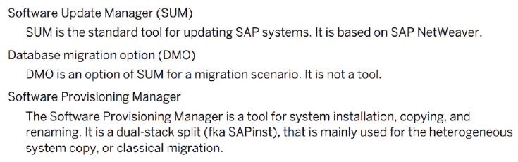
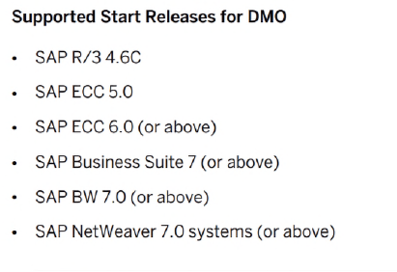
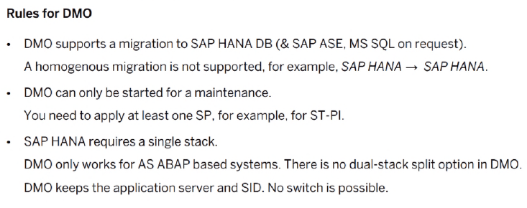
Technical Aspects of DMO

Slide 4
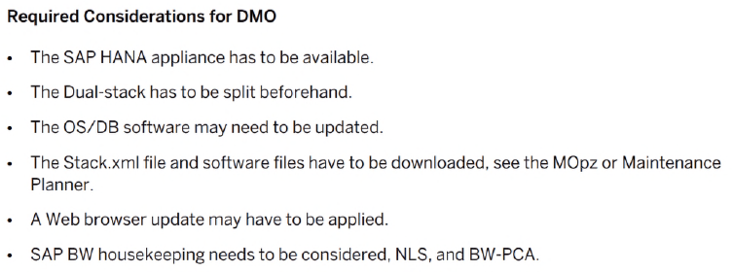
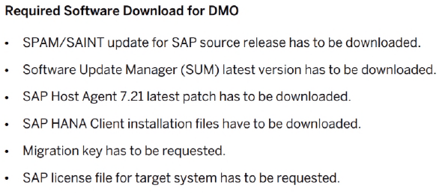
Technical Aspects of DMO

Slide 5
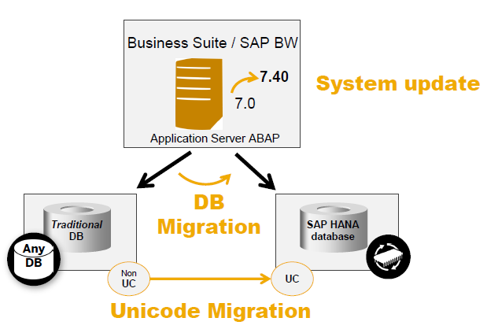
DMO at a Glance
The processing sequence is based on the shadow system functionality of SUM:
The SUM creates the shadow repository on the traditional database until downtime phase, while in parallel the target database is being set up (such as client, schema).
2. The shadow repository is copied to the target database. Then the downtime starts.
3. After the migration of the application data (including data conversion), the update is finalized and the SAP system runs on the target database.
The Source database continues to run and it is not modified. It remains as a fallback for the Reset Option throughout the complete DMO procedure. After the successful DMO procedure however, it cannot be used anymore as a productive database for an SAP system in parallel with the target database. It remains as a fallback for the reset procedure throughout the complete procedure.

Slide 6
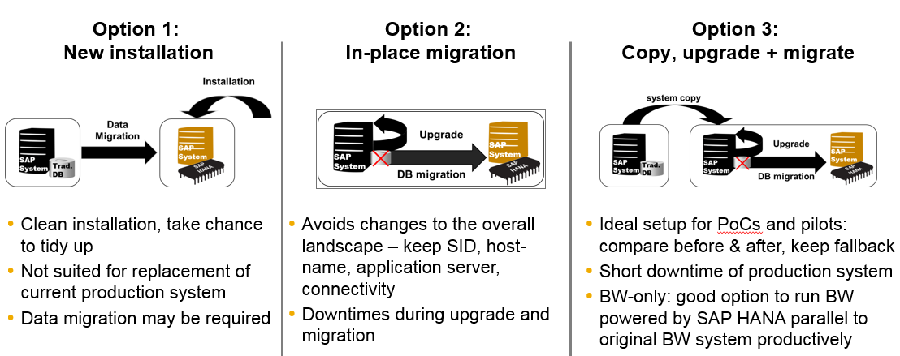
Migration Options

Slide 7
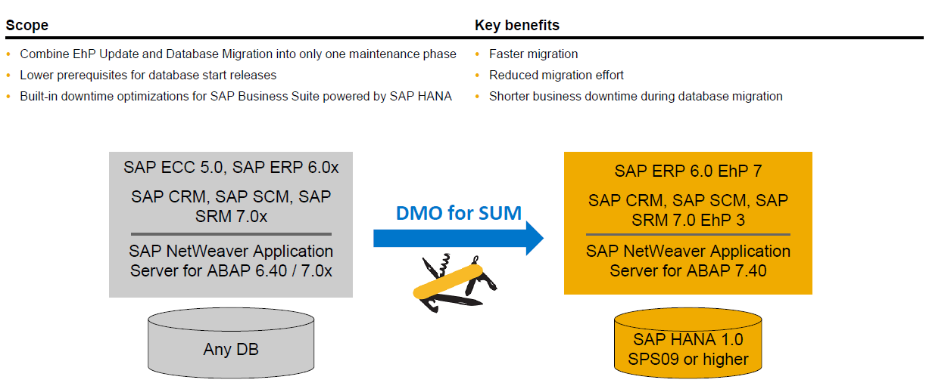
Update and Migration with Database Migration Option (DMO) tool

Slide 8
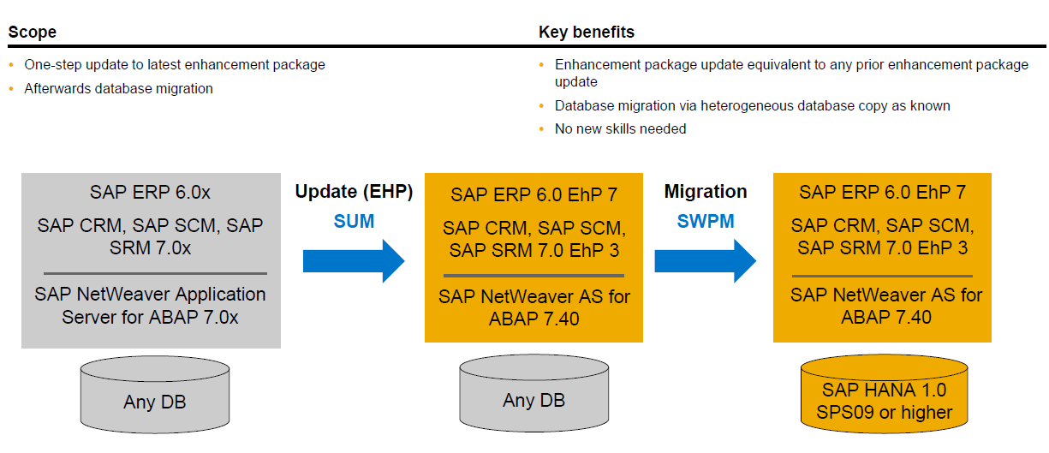
Update and Migration with SUM and SWPM

Slide 9
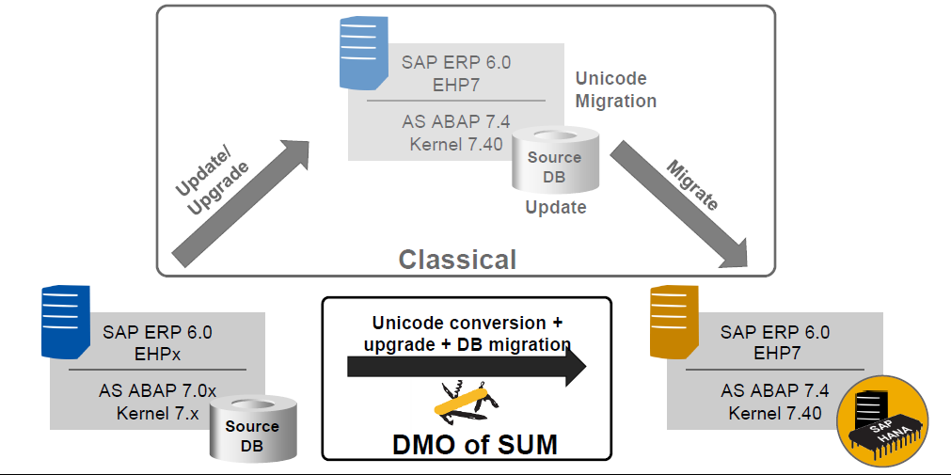
HANA Database Migration Tools – SWPM vs. DMO

Slide 10
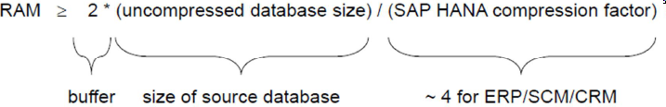
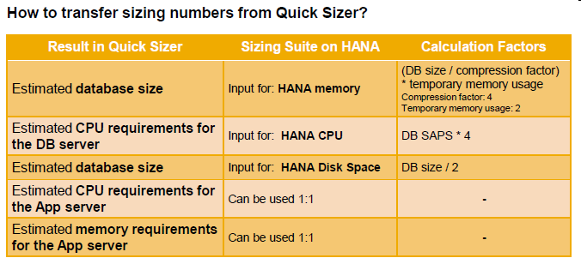
SOH Sizing Guidelines
Sizing Principles (Apply rules as given in note 1793345)
Memory (most important sizing driver)
Memory sizing is determined by the data footprint in SAP HANA (business and meta data in column and row store)
Memory is also being used by other components (e.g. HANA caches and operating system)
Sizing = Memory
Disk & CPU
Disk is required for data persistence and for logging data
Disk sizing is pre-determined by the size of memory (Appliance Concept)
# of CPU is pre-determined by the size of memory (Appliance Concept)
Relaxation available for non-Production Systems
Sizing formula is independent of whether the system is an
OLAP or OLTP system
Different CPU utilization HANA vs. any DB

Slide 11
Sizing Guidelines (contd..)
HANA Main Memory For HANA appliance / main memory sizing use SAP note 1872170
For a rule-of-thumb sizing, take half of the size of an uncompressed but "well-maintained" disk-based database and include a safety buffer of 20%.
Example: For a 1.8 TB DB (tables plus indexes), a HANA appliance of 1TB. Add future data growth into your planning.
Secondary Indexes: Review note number 1794297 for information regarding secondary indexes and the opportunities to save memory space on secondary indexes in certain cases
Application Server No changes concerning CPU, memory and network requirements for the ABAP application server; Existing hardware and network infrastructure can still be used.
Scale-up vs. Scale-out for HANA database servers Scale-up is increasing the memory, CPU and disks up to the maximum capacity of a physical server. When scale-up cannot provide the capacity needed, you can add more servers to increase the capacity of the database server, and this is called scale-out.

Slide 12
Sizing for SOH (contd..)
Note 1872170
Cannot be implemented with SNOTE. The installation must be done manually
Step 1. Create the database tables (Optional step). ZTAB_CS_SIZE and ZTAB_RS_SIZE
Step 2. Create function group ZHDBSIZING & function module Z_COLLECT_STATS & include LZHDBSIZINGTOP
Step 3. Create report ZNEWHDB_SIZE
Report (ZNEWHDB_SIZE)
Analyses all (or selected) tables on the source system and estimates their size on HANA.
Uses data sampling
Is independent of the source DB provider
Considers distribution of tables to row/column store
Considers de-clustering / de-pooling
Considers differences for secondary indexes
Note : Current estimation for memory required for HANA is more than two times the memory used for the tables.

Slide 13
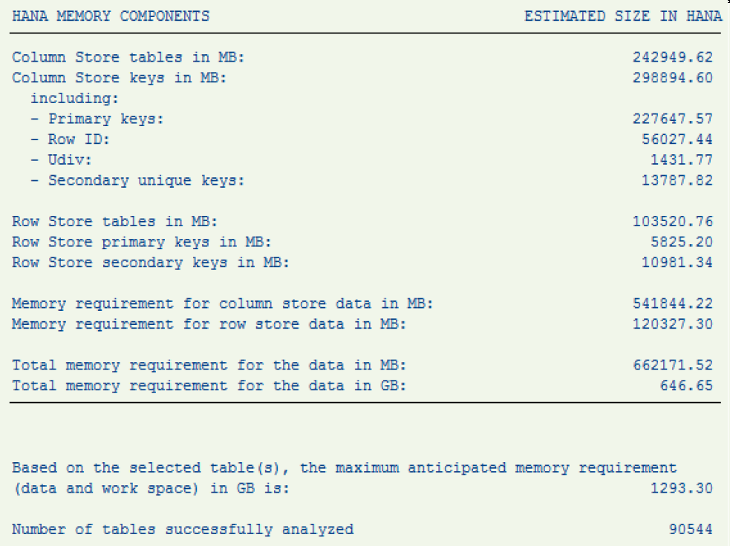
Report output : ZNEWHDB_SIZE (Note 1872170)
The report estimates the maximum memory consumption that would be required to load the selected data in the memory of a server running SAP HANA just after the migration to HDB. The report considers that all the columns of the column store are loaded regardless if they are used or not. This must be considered as a high water mark.

Slide 14
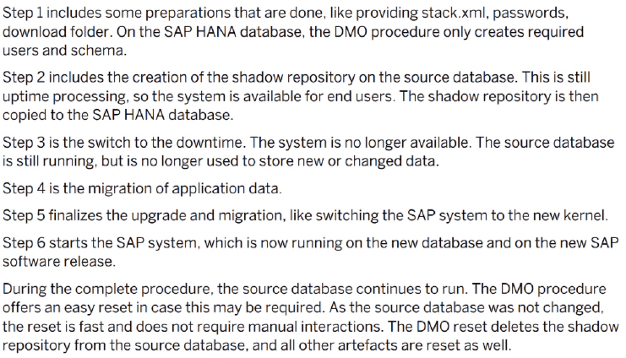
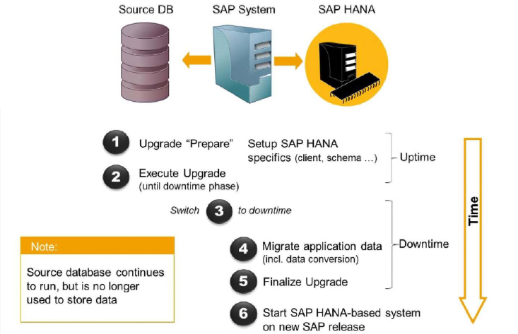
Overview of DMO phases executed by SUM tool

Slide 15
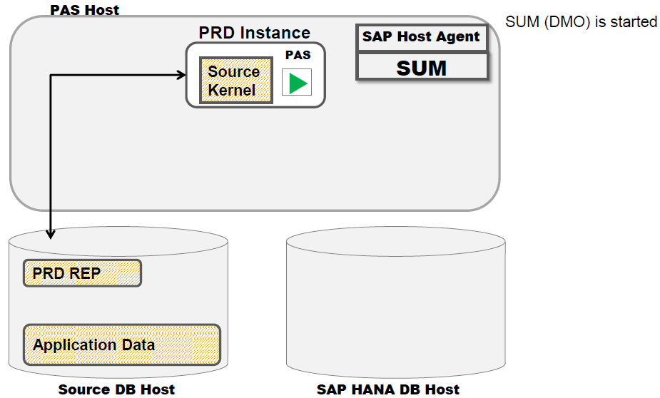
Minimized Downtime Approach – Process Step by Step
Downtime optimized DMO will reduce the downtime of the DMO procedure. It integrates a technology to enable the migration of selected (big) application tables during uptime processing of DMO, thereby reducing the downtime migration time.
During uptime processing, the source system is still available for end users. End user activity in the system may change application tables, so if these tables have already been migrated to the target database (SAP HANA database), the changes have to be recorded and transferred to the target database as well. A dedicated technology offers the required procedure to set triggers on the respective application tables to create log entries, frequently analyze the logs, and transfer the delta to the target database.

Slide 16
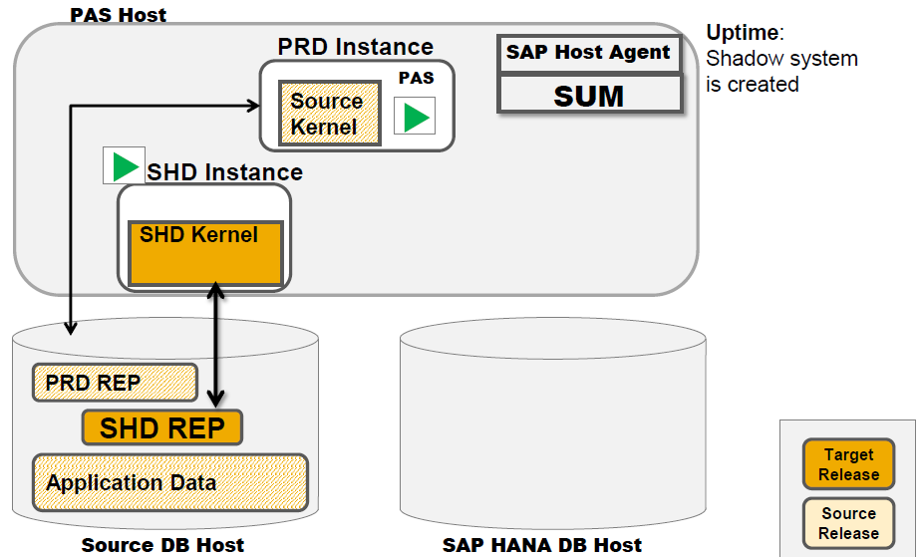

Slide 17
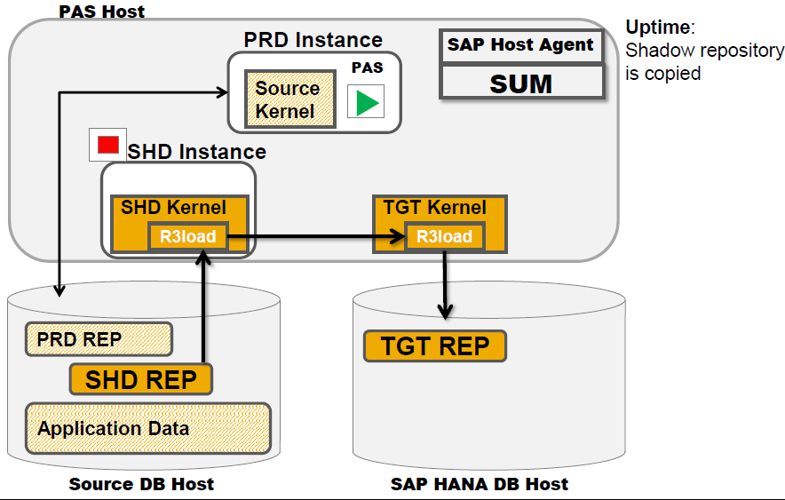
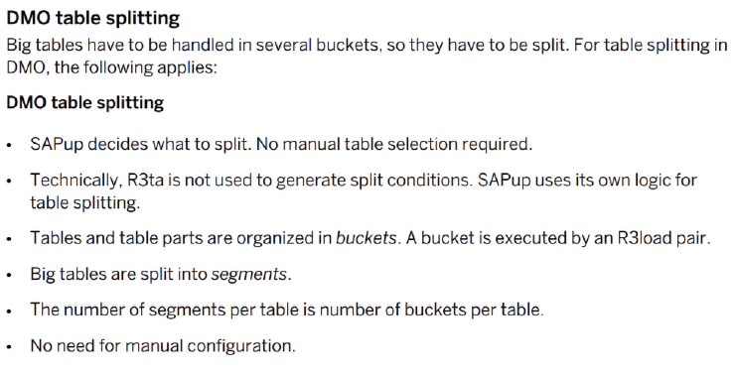

Slide 18
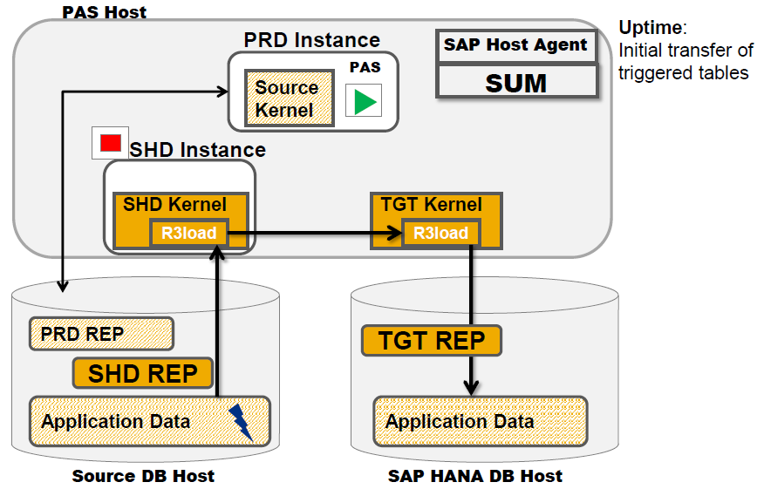

Slide 19
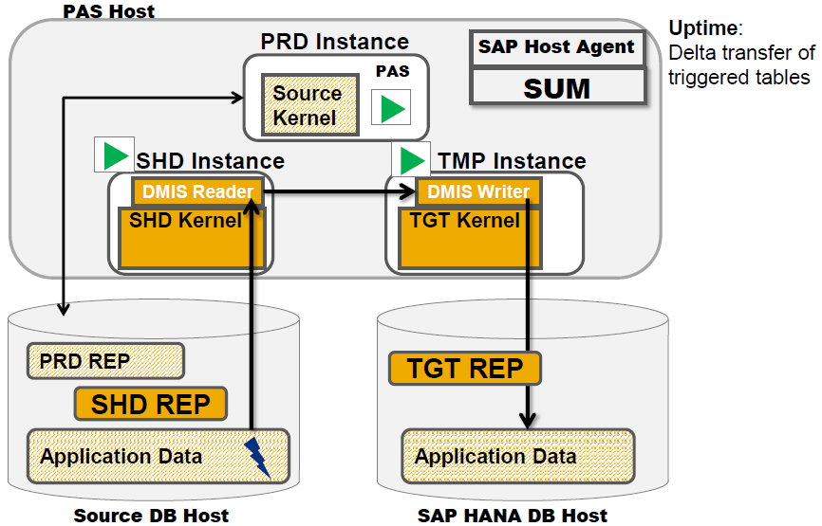

Slide 20
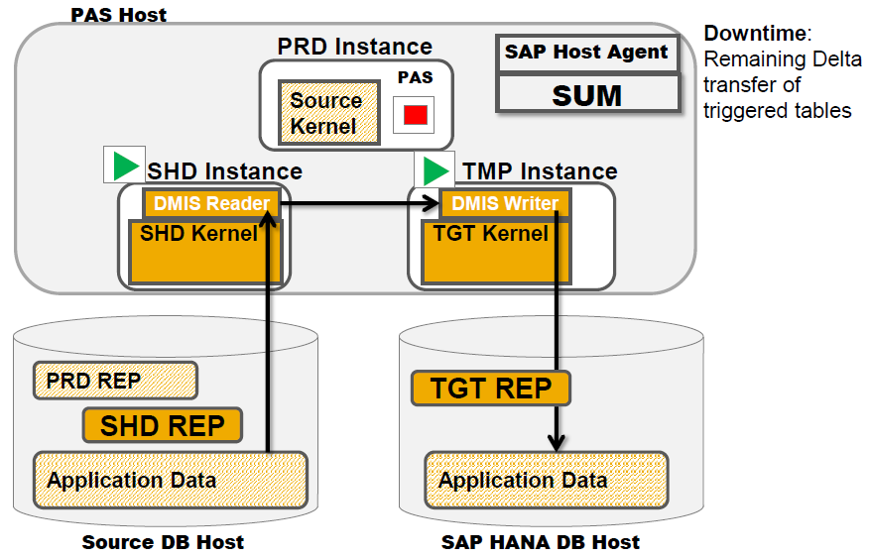
Downtime starts, now the remaining delta
of the application tables are migrated.

Slide 21
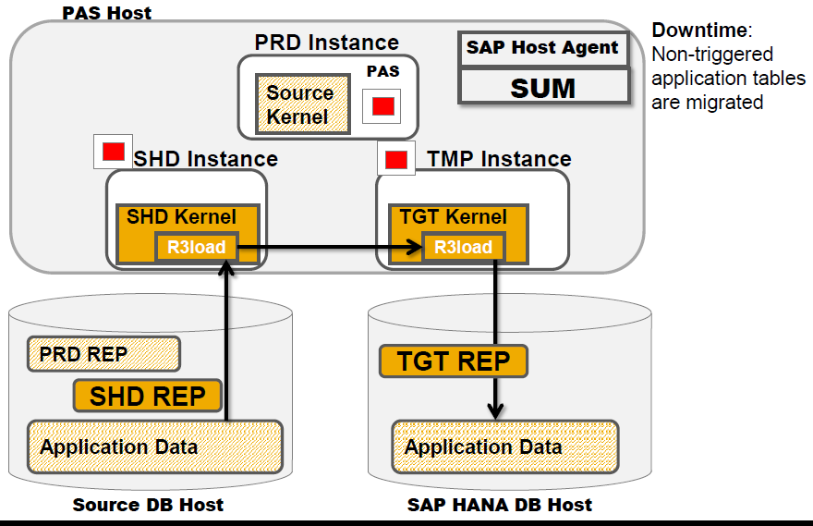

Slide 22
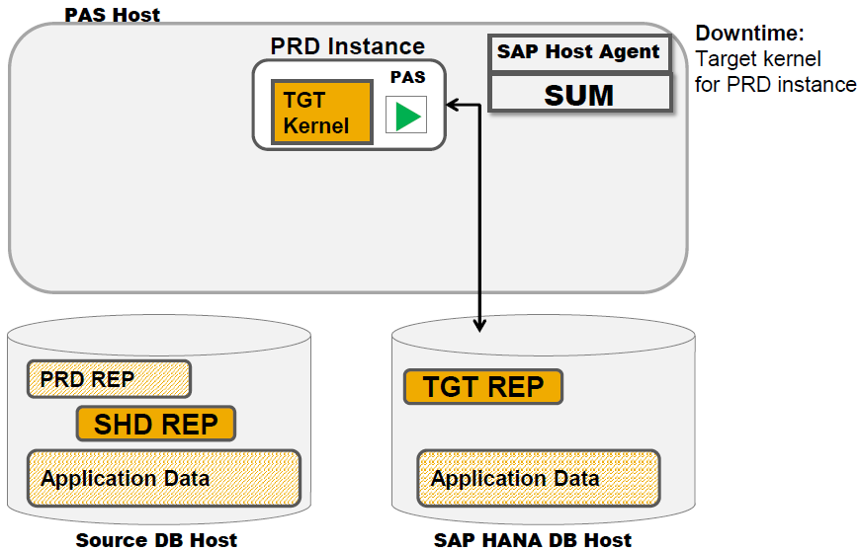
The target kernel is now applied to the PRD instance, the system is started to allow the update of the application tables. This is still business downtime.

Slide 23
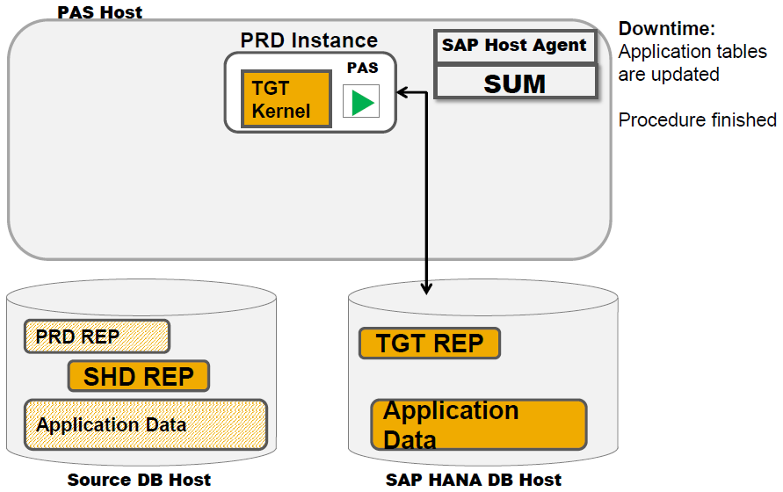
Once the application tables are updated and the procedure is finished, the system is available again.

Slide 24
HANA Database Migration – Source System Export Prep
Check SAP Kernel version (e.g., 7.40 patch 14, ABAP Stack is 616 SP2)
Check VBDATA table for entries
Set all the released jobs from released to scheduled
Operation mode
Logical system names
QCM tables deleted
Check log backup in HANA to see if it is enabled. Default value is enabled
Check for cluster/pool tables and execute the report SDBI_CLUSTER_CHECK
Generate the migration key
Generate DDL Statement

Slide 25
HANA Database Migration – Target System Prep
Check DBSIZE.XML
Check disk space on target app server
Download migration software
Set environment variable HDB_MASSIMPORT as in OSS note 1775293
Check space on HANA database
Check HANA client and HANA database are on the same version
Check network connectivity between app and HANA database server

Slide 26
HANA Database Migration – Export & Import
Source System Export – using SWPM
Choose the correct source system type (Business Suite Type / Database Type)
For example, SAP ERP powered by SAP HANA 1.0 & IBM DB2 for Linux, UNIX, and Windows
SAP HANA Database as Target Database Type
SAP System Split STR Files for table splitting
Target System Import – using SWPM
Choose System Copy and Import as Standard System Based on AS ABAP under Target
Code Page – conversion takes place if source and target application servers are different type
Migration Key is required

Slide 27
HANA Database Migration – Post Migration Activities
Technical Post-Migration Tasks –
HANA specific:
run python script to load all tables into memory
don't normally execute this because HANA is lazy loading which only loads when needed. Some customers want to load all tables when there is enough memory to save the initial loading time.
sonhana:/usr/sap/SOH/SYS/exe/hdb> python ./python_support/loadAllTables.py --user=SAPSOH --password=<%$#@!> --address=sonhana.bcsdc.lexington.ibm.com --port=30015 --namespace=SAPSOH
Rest of the activities similar to subsequent to any system copy/migration:
SGEN/STMS/SE06/Spool Admin
Technical integration tasks – confirm SAP connections and communication with external systems. Add-on products are tested and functioning.
Infrastructure Integration – confirming Backup/Recovery, High Availability, Disaster/Recovery, Solution manager monitoring and integration, SLD integration, 3rd party monitoring solutions, proprietary tools.
Business Process Validation – full testing and verification of ECC functional processes
SAP GOINGLIVE CHECK – verification of system migration and optimization by SAP Active Global Support

Slide 28
HANA Database Migration – Lessons Learned
Understand current landscape and add-on’s impact when SOH will be available– if availability delays are anticipated consider a target Suite accelerator vs. full Suite on HANA
Ensure archiving and system cleanup are considered and reviewed prior to launching SOH project
Do plan to evaluate and be prepared to remediate any custom ABAP if necessary
Understand the Suite on HANA Support Timeline
Not all Business Processes are Supported in SP0 (Note 1768031)
Not all Industry Solutions are Supported in SP0 (Note 1768031)

Slide 29


